Slide 1
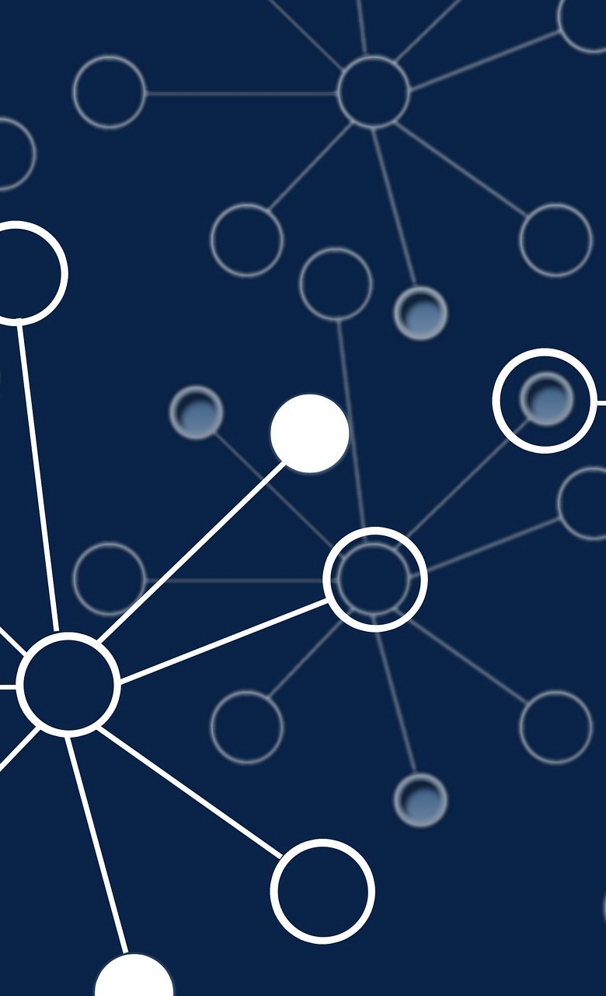
A Game-Theoretic
Approach to
Robustness of Routing YASHWANTH KARUPPUSAMY
Primary supervisor – Dr. Arno Pauly
Secondary supervisor – Dr. Joseph Macinnes

Slide 2

Overview:
Routing can be modeled as a game on a directed graph.
Each vertex represents a server and can choose which outgoing edge to use to route data.
The goal of most servers is to keep the data moving as far as possible, while a few servers try to interfere.
The amount of interference that these agents can accomplish is studied.

Slide 3
There are several challenges that can arise in routing, including:
Scalability: As the size of the network increases, it becomes more difficult to find efficient routes.
Robustness: Routing algorithms need to be able to handle changes in the network, such as the addition or failure of nodes or links.
Security: Routing algorithms need to be designed to prevent malicious attacks, such as spoofing or routing loops.

Slide 4

Game theory has a number of applications in networking and communication systems. For example:
Network design
Network security
Communication protocols

Slide 5

Literature review:
Previous work on routing and game theory.
Relevant concepts and techniques from game theory that can be applied to routing.
Limitations and gaps in the existing literature review.

Slide 6
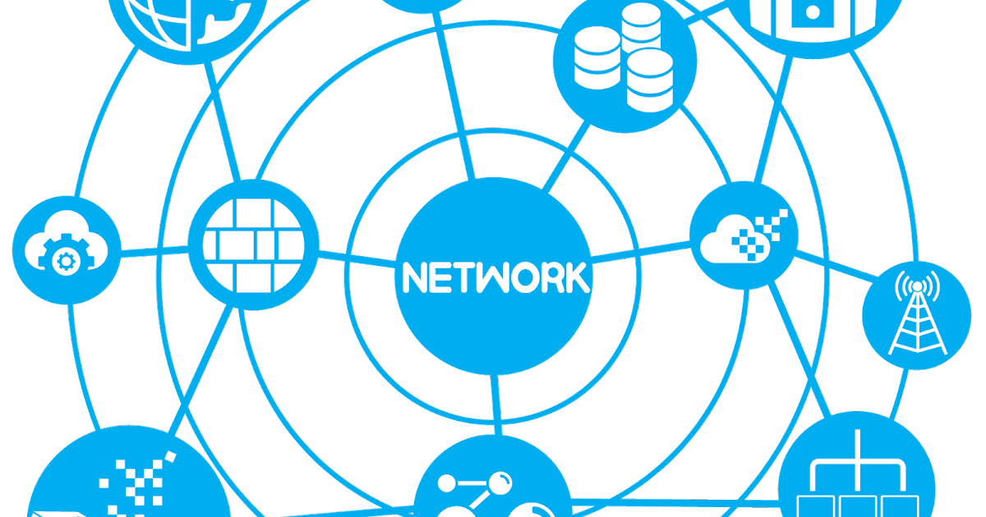
The purpose of the paper is to explore the use of game theory to improve the efficiency of routing systems.
The current state of routing algorithms is analyzed, including potential vulnerabilities such as compromised nodes.
A new approach using game theory is proposed to find the shortest and most secure path for data transmission, involving the representation of each system as a vertex.
d .

Slide 7
The impact of compromised nodes on the network is considered and how game theory can be used to find alternative routes is demonstrated.
The aim of the study is to demonstrate the potential benefits of using game theory in routing systems and provide a basis for further research.
A simulation in Java is implemented to evaluate the proposed approach, using a graph representation of the network and determining the optimal path and Nash equilibrium.
d .

Slide 8

Methodology:
Creation of Game graph using java.
Finding the shortest path.
Finding Equilibrium of those paths.
If any compromised node in the graph, then avoid that node as long as possible.

Slide 9
Methodology:
Game graph contains Nash class and Graph class
The Graph class has a constructor that takes a string parameter and constructs two type of graphs.

Slide 10
Finding Shortest path:
The printShortestPath() method prints the shortest path between two vertices in a graph and returns the number of levels in the path.
The findShortestPath() method uses Dijkstra's algorithm to find the shortest path.
The findShortestPath() method uses a queue and an array of visited vertices to traverse the graph and finds the shortest path by storing the parent of each visited vertex in an array.

Slide 11
Finding Equilibrium:
The main method creates a HashMap and a TreeSet to store the Nash equilibrium and distances, respectively.
The main method allows the user to input a compromised node in the graph, and uses this information to find the shortest path between each node and a destination node.
The main method calculates the Nash equilibrium of the shortest paths found by comparing the paths and eliminating duplicates.

Slide 12
Conclusion
It was concluded that a game-theoretic strategy can be used to improve the robustness of routing in network systems.
According to the data obtained, game-theoretic techniques may be able to increase the dependability and robustness of routing protocols and protect against various disruptions and attacks.
Overall, the findings suggest that game theory is a useful tool for addressing challenges with routing in complex network systems.

Slide 13

Future Work:
Investigating how well the game-theoretic method works in other kinds of networks, such as networks with differing topologies or levels of connectedness, among other possible network configurations.
Investigating how the existence of malevolent players or the addition of additional restrictions or goals affects the resilience of routing solutions and studying the influence of the various other elements that might have this effect.

Slide 14
THANK YOU

